Slide 1
Introduction to Shiny
LondonR Workshop
March 30th 2015

Slide 2
WiFi
UCLGuest Wireless Network
Navigate to a page outside of UCL
Click on the link to the self service page
Enter your details and event code (CDRC)
Click Generate Account
Make a note of the username and password
Click on the link to login

Slide 3
Workshop Aim
Be able to develop a simple Shiny App with standard inputs and outputs
A subset of Mango's forthcoming Shiny training course!

Slide 4
Outline
A Basic Shiny app
Defining the User Interface
Displaying Outputs
Reactivity
Beyond the Basics

Slide 5
Workshop resources
R (version 3.1.2)
RStudio
Shiny (version 0.11)

Slide 6
Workshop structure
2 hours
Presentation format
Worked examples of creating apps
Exercises during the workshop

Slide 7
What is Shiny?
R Package for Interactive Web Apps developed by RStudio
Gives the power of R in a convenient user interface
Can be written entirely in R

Slide 8
A Basic Shiny App
A basic app requires:
A user interface script
A "Server" script
Runs using the runApp function

Slide 9
The User Interface Script
Defines the components of the user interface
Page titles
Input options
Outputs
Defines what the user will see and interact with

Slide 10
The Server Script
Contains the information to build the app
Requires a call to the function shinyServer
Contains a function with parrmeter input and output
Defines what happens in R

Slide 11
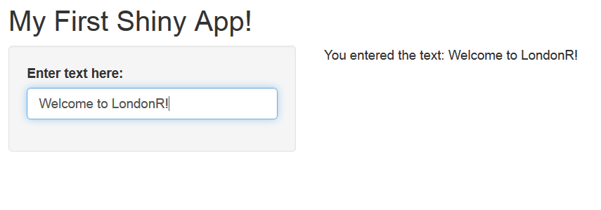
Worked Example 1

Slide 12
Worked Example 1 - UI
shinyUI(fluidPage(
titlePanel("My First Shiny App!"),
sidebarLayout(
sidebarPanel(
textInput("myText", "Enter text here:")
),
mainPanel(
textOutput("niceTextOutput")
)
)
))

Slide 13
Worked Example 1 - Server
shinyServer(function(input, output){
output$niceTextOutput <- renderText(paste("You entered the text:\n", input$myText))
})

Slide 14
Layouts
Example 1 used a sidebarLayout
There are a number of possible layouts
In this workshop we will only use the sidebarLayout

Slide 15
Sidebar Panel
Define the contents of the sidebar using the sidebarPanel function
Accepts *Input functions that specify the app inputs

Slide 16
Input Controls
Input | Description
textInput | Text string input
numericInput | Numeric value input
selectInput | Select single or multiple values from drop down list
sliderInput | Numeric range “slider” input
radioButtons | Set of radio button inputs
fileInput | File upload control

Slide 17
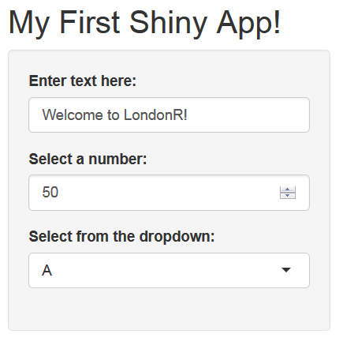
Worked Example 2

Slide 18
Worked Example 2 - UI
sidebarPanel(
textInput("myTextInput", "Enter text here:"),
numericInput("myNumberInput", "Select a number:", value = 50, min = 0, max = 100, step = 1),
selectInput("mySelectInput", "Select from the dropdown:", choices = LETTERS[1:10])
)

Slide 19
Main Panel
Define the contents of the main panel using the function mainPanel function
Can contain outputs using the *Output functions
Can include HTML using a series of functions that replicate the HTML tags

Slide 20
HTML Formatting
We don't need to use HTML tags
Shiny includes a series of equivalent functions
Function | Usage
p | A paragraph of text
h* | A level * (1, 2, 3,...) header
code | A block of code
img | An image
strong | Bold text
em | Italic text

Slide 21
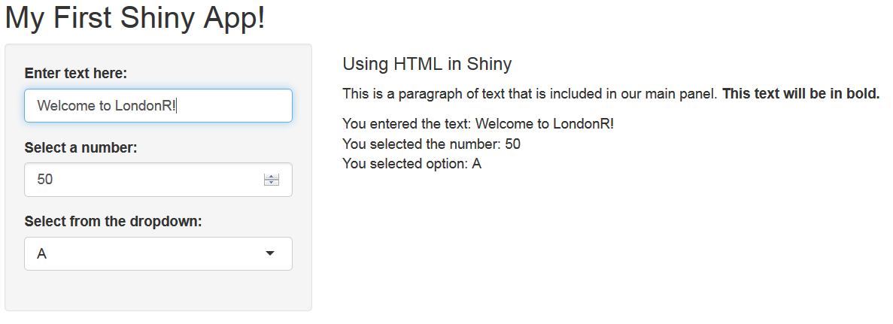
Worked Example 2

Slide 22
Worked Example 2 - UI
mainPanel(
h4("Using HTML in Shiny"),
p("This is a paragraph of text that is included in our main panel.", strong("This text will be in bold.")),
textOutput("niceTextOutput"),
textOutput("niceNumberOutput"),
textOutput("niceSelectOutput")
)

Slide 23
Exercise 1
Build a simple Shiny application that takes a date string input (e.g. “30-03-2015”) and returns the following text:
What day of the week is it (e.g. “Wednesday”)
What month it is (e.g. “December”)
What year it is
Hint: try using the dateInput and format functions

Slide 24
Exercise 1 - UI
require(shiny)
shinyUI(fluidPage(
# Define the header for the page
titlePanel("Exercise 1"),
# Set up the page to have a sidebar
sidebarLayout(
# Define the contents of the sidebar
sidebarPanel(
dateInput("dateInput", "Select date")
),
# Define the contents of the main panel
mainPanel(
textOutput("dateOutput")
)
)
))

Slide 25
Exercise 1 - Sever
require(shiny)
shinyServer(function(input, output){
output$dateOutput <- renderText(
format(input$dateInput, format = "A %A in %B. The year is %Y")
)
})

Slide 26
Defining Outputs
So far we have just output text
Shiny also allows us to output graphics, data and images
We have to define the output in the UI and the Server scripts using different functions

Slide 27
Rendering Outputs
Output Type | server.R Function | ui.R Function
Text | renderPrint | textOutput
Data | renderDataTable | dataTableOutput
Plot | renderPlot | plotOutput
Image | renderImage | imageOutput

Slide 28
Worked Example 3 - Render Data
From the user interface select a dataset from a dropdown menu
Display the data in a dataTable

Slide 29
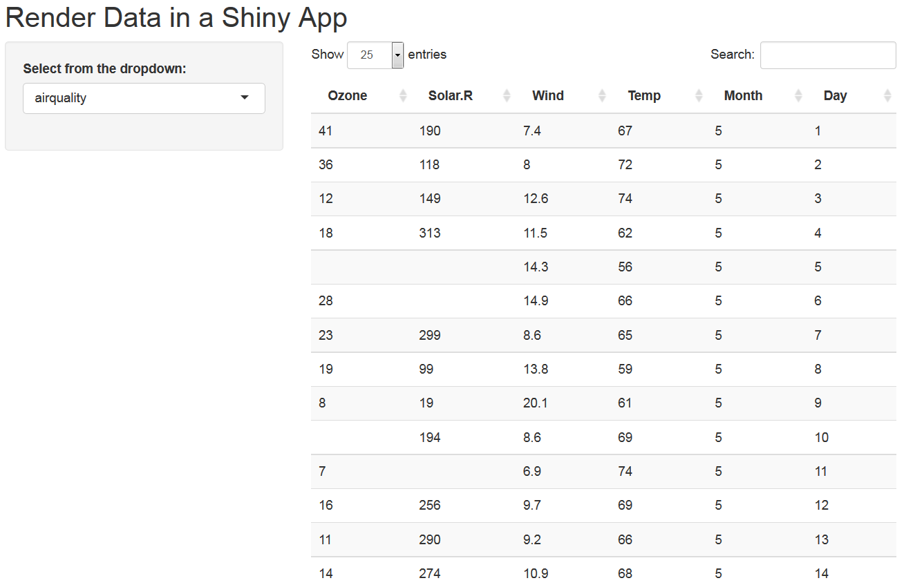
Worked Example 3 - Render Data

Slide 30
Worked Example 3 - UI
sidebarLayout(
sidebarPanel(
selectInput("selectInput", "Select from the dropdown:", choices = c("airquality", "iris", "mtcars"))
),
mainPanel(
dataTableOutput("dataOutput")
)
)

Slide 31
Worked Example 3 - Server
output$dataOutput <-
renderDataTable(switch(input$selectInput, "airquality" = airquality,
"iris" = iris,
"mtcars" = mtcars)
)

Slide 32
Worked Example 4 - Render Plots
Select a column of the data from a drop down menu
Plot a histogram of the data

Slide 33
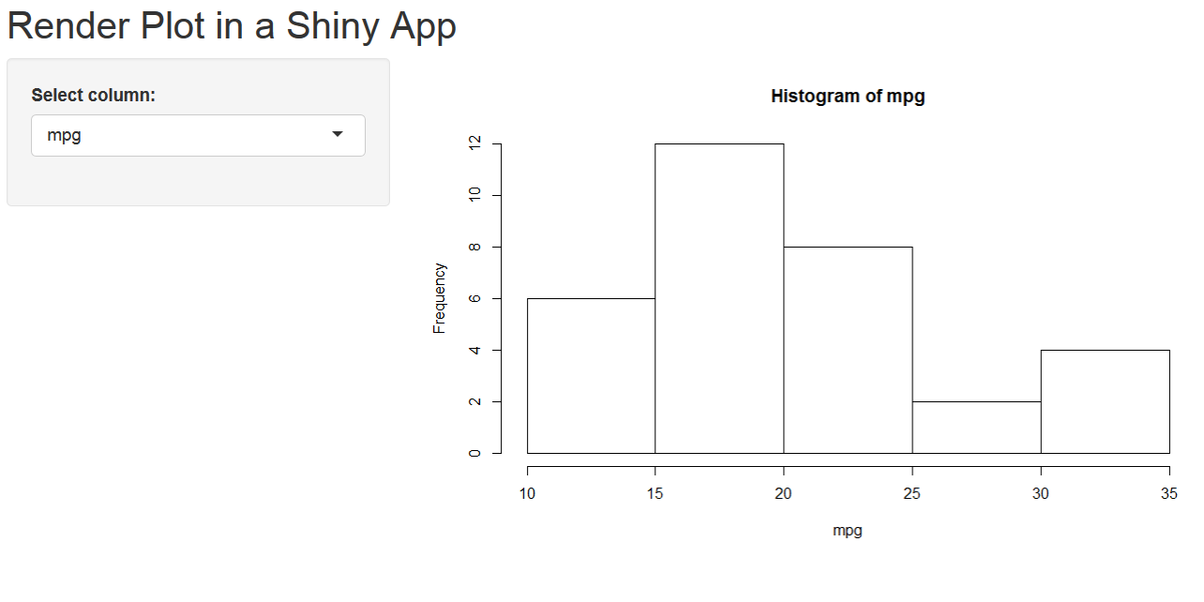
Worked Example 4 - Render Plots

Slide 34
Worked Example 4 - UI
sidebarLayout(
sidebarPanel(
selectInput("selectInput", "Select column:", choices = colnames(mtcars))
),
mainPanel(
plotOutput("plotOutput")
)
)

Slide 35
Worked Example 4 - Server
output$plotOutput <- renderPlot(
hist(mtcars[,input$selectInput], main = paste("Histogram of", input$selectInput),
xlab = input$selectInput)
)

Slide 36
Exercise 2
Create a Shiny application that takes:
A numeric value between 1 and 500
A colour
A main title
Use these inputs to create an output histogram of random data from any distribution where n is the numeric input

Slide 37
Exercise 2 - UI
require(shiny)
shinyUI(fluidPage(
# Define the header for the page
titlePanel("Render Plot in a Shiny App"),
# Set up the page to have a sidebar
sidebarLayout(
# Define the contents of the sidebar
sidebarPanel(
numericInput("numberInput", "Select size of data:", min = 0, max = 500, value = 100),
selectInput("colInput", "Select a colour", choices = c("red", "yellow", "blue", "green"))
),
# Define the contents of the main panel
mainPanel(
plotOutput("plotOutput")
)
)
))

Slide 38
Exercise 2 - Server
require(shiny)
shinyServer(function(input, output){
output$plotOutput <- renderPlot(
hist(rnorm(input$numberInput), col = input$colInput)
)
})

Slide 39
Reactivity
Consider the last exercise...
Suppose we want to change the colour of the plot, what happens to the data?

Slide 40
Reactivity
Each time we change an option the data is simulated again
Suppose this was reading in a large dataset, connecting to a database etc.

Slide 41
The reactive Function
This lets us create a reactive function
The function is only called when the relevant inputs are updated
Our data is only updated when the number of simulations is changed

Slide 42
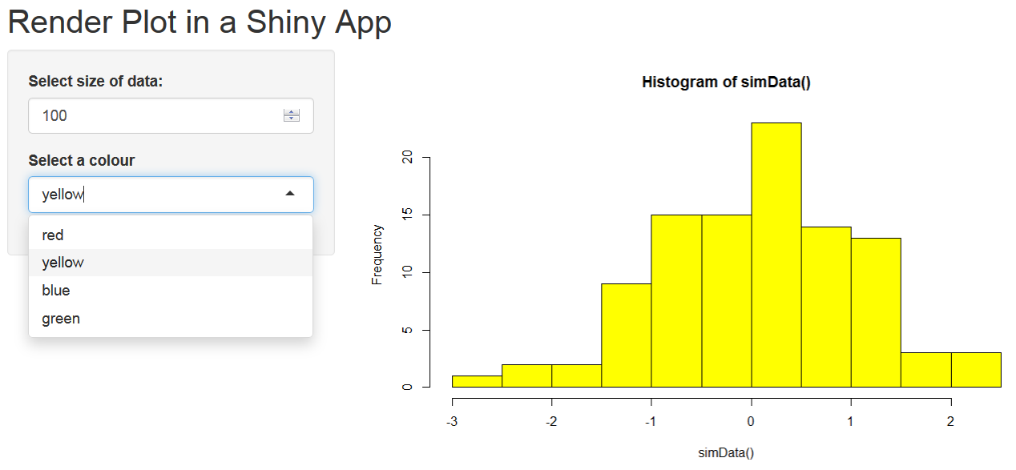
Worked Example 5

Slide 43
Worked Example 5 - Server
simData <- reactive({
rnorm(input$numberInput)
})
output$plotOutput <- renderPlot(
hist(simData(), col = input$colInput)
)

Slide 44
Beyond the basics
Changes to layouts
Including tabbed pages
Include CSS to style the page
Incorporate Shiny and Markdown
Share your app
...
All covered on our 1 day Getting Started with Shiny course

Slide 45
Shiny Themes
A new package that allows us to change the bootstrap theme
Requires Shiny v0.11
Available on CRAN
http://rstudio.github.io/shinythemes/

Slide 46
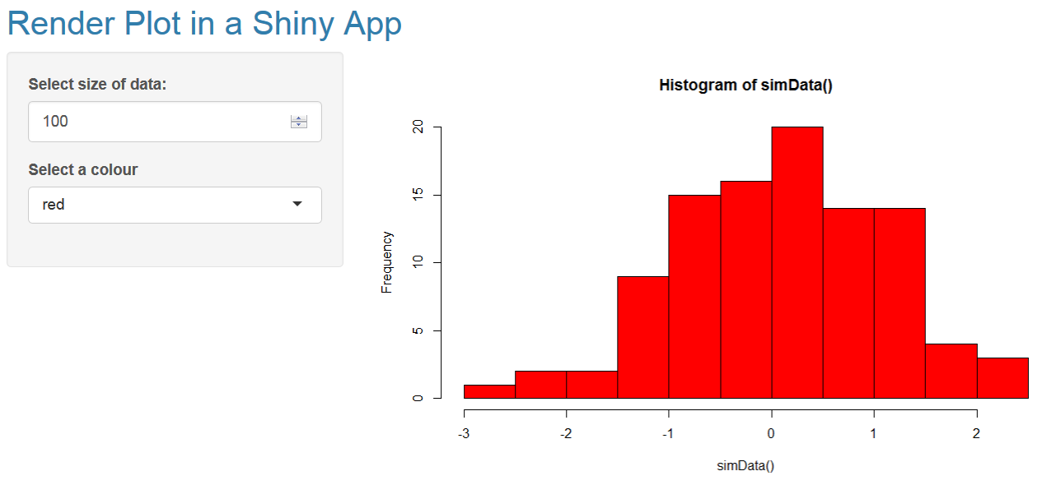
Worked Example 6

Slide 47
Worked Example 6 - UI
require(shinythemes)
shinyUI(fluidPage(
theme = shinytheme("cerulean"),
...
))

Slide 48
Shiny Dashboard
Package under development by RStudio for developing Dashboards with Shiny
Available on github

Slide 49
What Next?
This evenings LondonR meeting!
Getting Started with Shiny training course
Data Visualisation in R training course
EARL 2015

Slide 50
LondonR tonight
SAS to R Migration – Rich Pugh, Mango Solutions
The Coder and the Designer: Using R for Visualising London's Data – James Cheshire, UCL (and Co-Author of The Information Capital)
How to build a mid-sized analytical application with Shiny – Enzo Martoglio, Sopra Steria

Slide 51
Getting Started with Shiny - May 27th
1 Day Training Course
Covers this content in more depth + more!
Including CSS
Shiny + Rmarkdown
To be held in central London
See the Mango team for more details!

Slide 52
Data Visualisation in R - May 28th
1 Day Training Course
The Principles of Data Visualisation
Implementing these principles in ggplot2
To be held in central London
See the Mango team for more details!

Slide 53

Tower Hotel
2 day conference
1 day of workshops prior to conference
Capacity for 400+
Conference evening event in Tower Bridge
Earlybird deadline ends tomorrow
Abstract deadline extended to 17th April

Slide 54
Alex Bellos (Author of Alex's Adventures in Numberland)
Joe Cheng (Creator of Shiny!)
Dirk Eddelbuettel (Author of Rcpp)
Hannah Fry (Lecturer in Mathematics at the Centre for Advanced Spatial Analysis)
Speak to the Mango team to know more or visit the webpage
http://www.earl-conference.com/

Slide 55
EARL Workshops
10.00 – 13.00
Integrating R and Python (Chris Musselle)
Current Best Practices in Formal Package Development (Aimee Gott, Gregoire Gauriot)
14.00 – 17.00
Introduction to Rcpp (Dirk Eddelbuettel)
Interactive reporting with R Markdown and Shiny (Joe Cheng)

Slide 56


Follow Mango!
@mangothecat
@earlconf
MangoTheCat

